Slide 1

Online Course Enrollment System
Xenia Reid
CST499 Final Project Presentation
August 5, 2025
Notes:
Hello everyone, my name is Xenia Reid, and I’m excited to present my capstone project for CST499: the Online Course Enrollment System. This platform allows students to register, log in, view courses, and manage their enrollment seamlessly.

Slide 2
Project Overview
Objective: Provide a streamlined online course enrollment platform.
Built With: PHP, MySQL, HTML/CSS
Key Features: Registration, login, course listing, enrollment, waitlisting
Notes:
This web-based application was developed using PHP and MySQL. Its goal is to give students an intuitive way to enroll in courses online, with secure registration and user-friendly features like course search, enrollment, waitlisting, and cancellation.

Slide 3
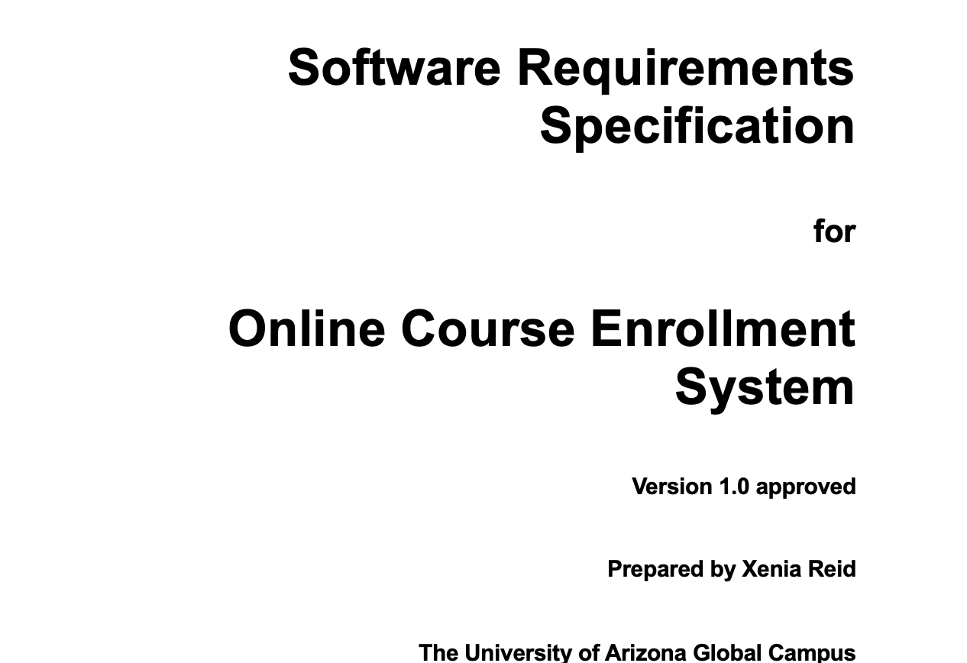
Software Requirements Specification (SRS) Summary
Scope: Semester-based enrollment system
Features:
User registration/login
Course browsing by semester
Enrollment with waitlist/cancellation
Users: Students (Admins in future scope)
Notes:
I began with a Software Requirements Specification, or SRS. The system is focused on students, with future plans for administrator support. Key features include registration, login, course browsing, and enrollment management with automated waitlists.

Slide 4
Functional Requirements
Registration (REQ-1 to REQ-3)
Login (REQ-4 to REQ-5)
Course Listing (REQ-6 to REQ-7)
Enrollment/Waitlisting (REQ-8 to REQ-10)
Cancellation (REQ-11 to REQ-12)
Notes:
Here are some of the core functional requirements. For example, the system ensures unique user IDs during registration, validates logins, updates course listings dynamically, and manages waitlists using a FIFO structure. Each requirement was labeled and prioritized

Slide 5
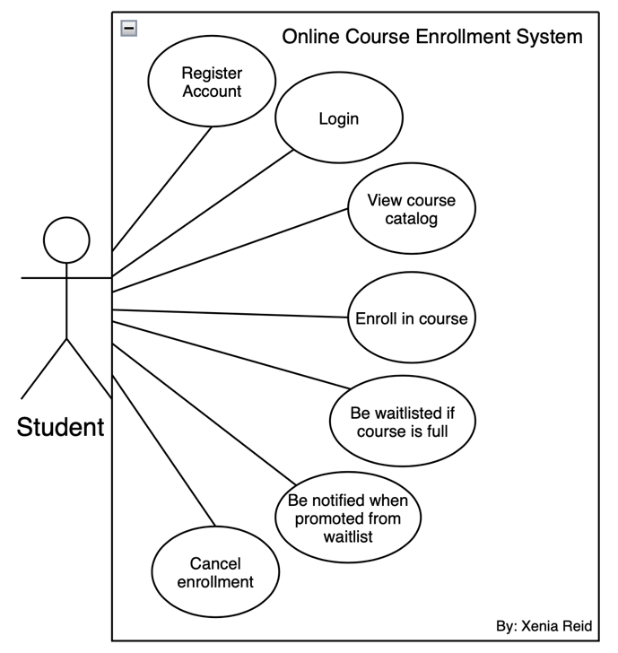
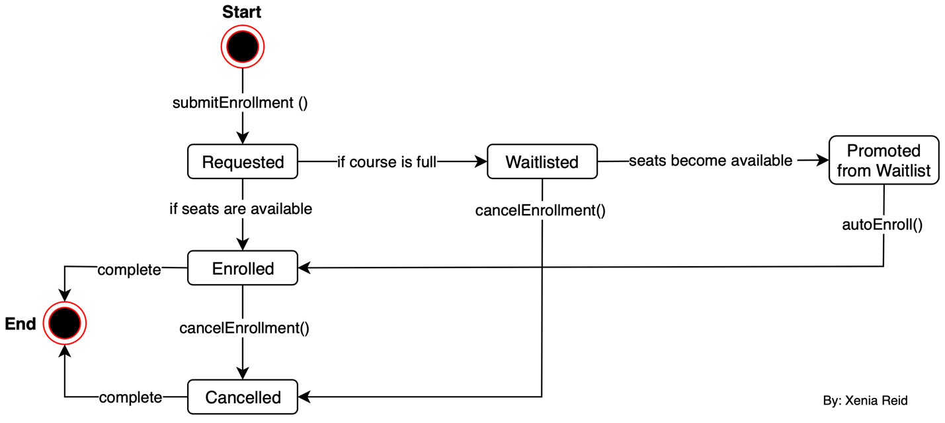
UML Design - Use Case & State Diagram
Use Case Diagram: Actors (Student), use cases (Register, Login, Enroll)
State Diagram: Registration → Login → Enroll → Drop Course
Notes:
The UML Use Case diagram outlines user interactions such as registering, logging in, and enrolling. The State diagram captures transitions, like a user going from login to enrollment, or cancelling a course and returning to the course list.

Slide 6
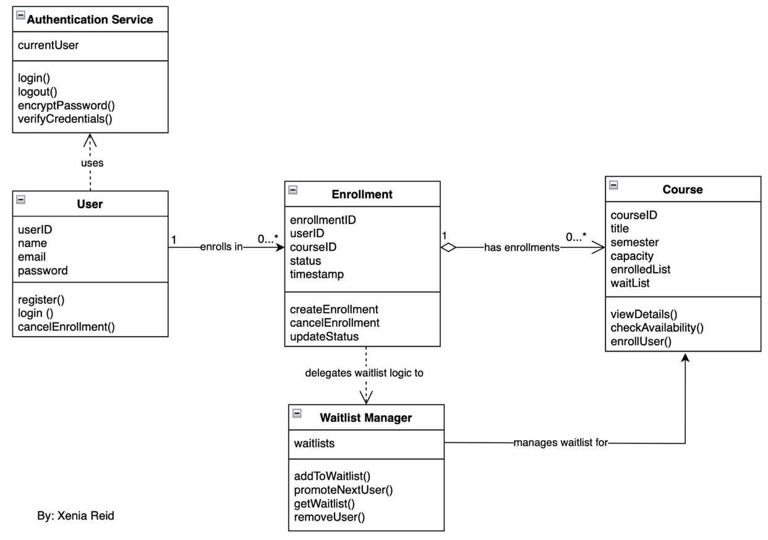
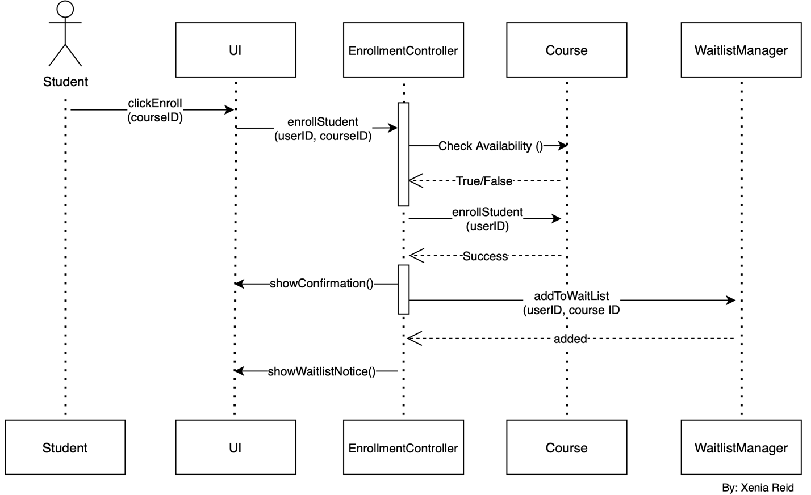
UML Design - Class & Sequence Diagram
Class Diagram: User, Course, Registration
Sequence Diagram: Register/Login, Enroll, Drop Course
Notes:
The Class diagram defines system objects—Users, Courses, Registrations—and their relationships. The Sequence diagram shows the interaction from user actions to database operations, like what happens when someone enrolls in a course.

Slide 7
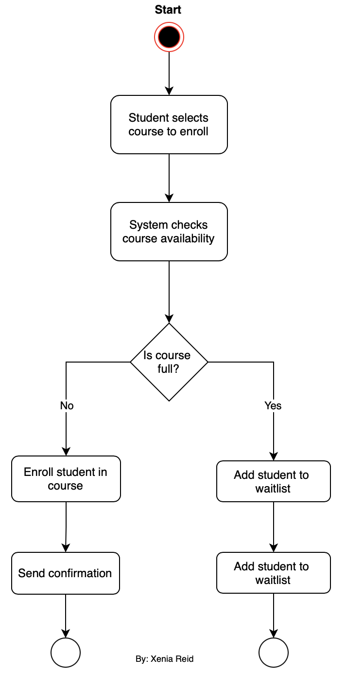
UML - Activity Diagram
This Activity diagram shows the user workflow from start to finish—registration, logging in, enrolling in a course, or dropping it. It helped structure the logic for the pages and the backend.
Notes:
This Activity diagram shows the user workflow from start to finish—registration, logging in, enrolling in a course, or dropping it. It helped structure the logic for the pages and the backend.

Slide 8
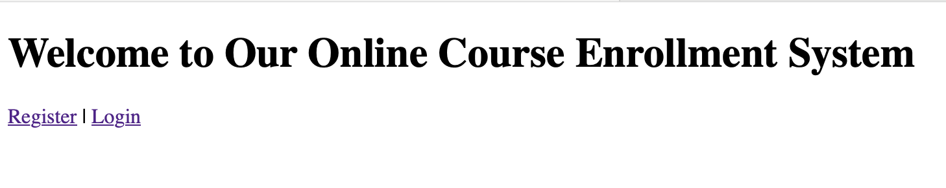
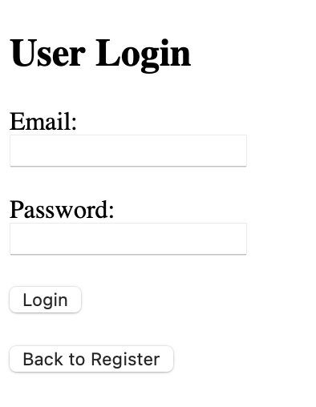
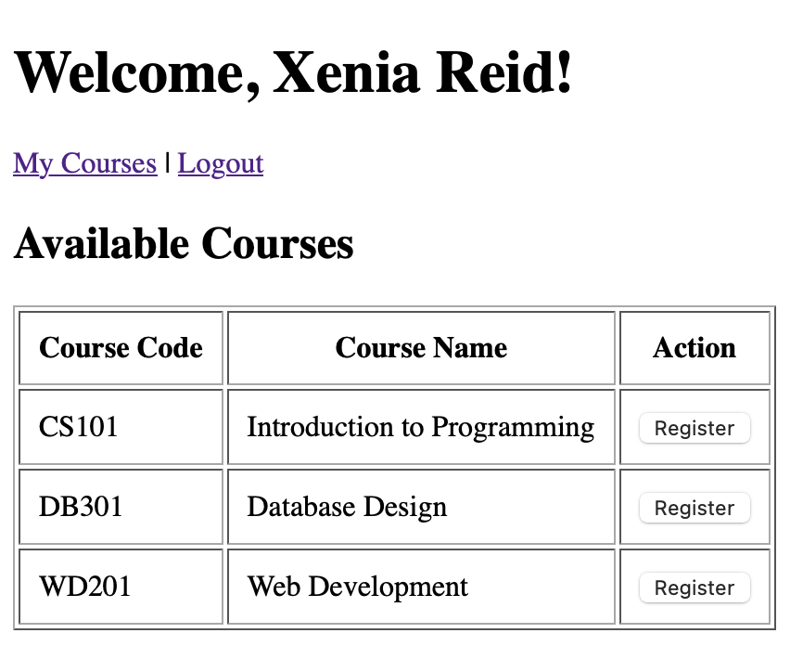
Page Designs (Landing, Login, Enrollment)
Login Page: Secure credential input
Landing Page: Entry point, links to Register/Login
Enrollment Page: Course list with registration option
Notes:
The system includes three key pages. The Landing page links users to Register or Login. The Login page uses password verification. The Enrollment page lists all available courses and lets students enroll in real time.

Slide 9
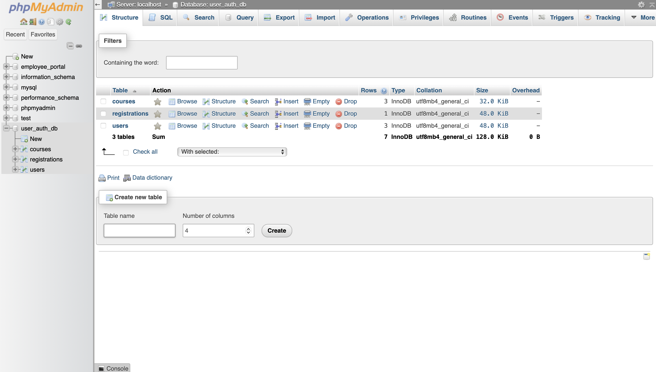
MySQL Database Design
Database: user_auth_db
Tables:
users – Stores user info
courses – Course data
registrations – Tracks course enrollment
Security: Password hashing with password_hash()
Notes:
I designed a relational database with three tables: users, courses, and registrations. I used prepared statements and password hashing to keep user data safe and reduce injection risk. The database structure keeps track of enrollments and drop actions efficiently.

Slide 10
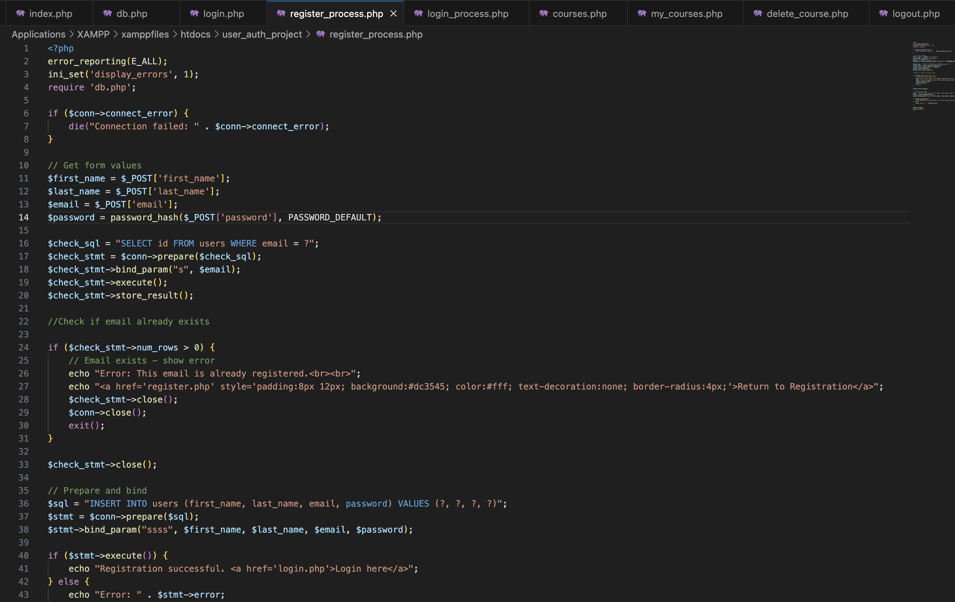
PHP Code Highlights
Key Features:
Secure Registration/Login (register_process.php, login_process.php)
Session handling
Prepared statements to prevent SQL injection
Modular connection class (db.php)
Notes:
The PHP code was written modularly. I used a custom database class to manage connections and prepared statements throughout to boost security. Passwords are hashed before storing, and sessions are used for authentication during login.

Slide 11
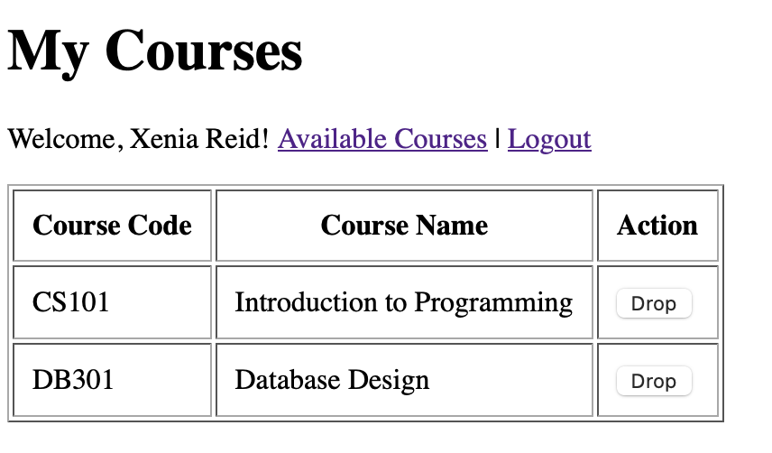
Class Registration Flow (PHP + MySQL)
User logs in → selects course → system checks if already registered → registers or shows message
Supports dropping courses (my_courses.php)
Backend validates and updates DB
Notes:
Once logged in, students see the course list. They can register for a course unless already enrolled, in which case they see a message. They can also view or drop courses through the my_courses.php interface, which updates the backend accordingly.

Slide 12
Final Thoughts
Future Scope: Admin panel, email notifications
Takeaway: Secure, user-friendly enrollment platform with core functionalities and scalable design
Notes:
In the future, I’d like to add features like an admin dashboard and email reminders for enrolled students. This project helped me reinforce full-stack development principles, especially around secure PHP and MySQL interactions. Thank you for your time!

Slide 13
Thank you!
Xenia Reid

